Slide 1
Mixture Solution development:
Some hard problems with easy solutions
Charles Brenner, Ph.D.
Purveyor of forensic mathematics
DNA∙VIEW®
Senior Fellow, UC Berkeley Human Rights
charles@dna-view.com
http://dna-view.com
2022 Spurenwork, Feb 17

Slide 2
My initial concepts
Mathematically sound and simple
Important problems
  Must solve the problem of locus linkage.
  Can solve “how many contributors”

Slide 3
The problem of linkage
Linkage problem is
    not between loci genetically;
    between locus *information* (specifically heights)
    (see notes below this slide in non-presentation mode)
Solved with simple math, without MCMC.
Notes:
Linkage between information of multiple loci:
Suppose suspect genotype matches the major contribution of locus 1 – evidence suspect contributed - and matches the minor contribution of locus 2 – also evidence suspect contributed. But combined they may well amount to evidence suspect did not contribute.
Hence unlike in the olden days, when binary mixture models unaware of heights meant it was correct to evaluate each locus independently then multiply their LRs, we now need to consider the loci all at once. Per locus there are a small number – perhaps 10 -- of genotype combinations to consider; instantaneous to calculate by computer. But if all loci must be considered as a unit, computation time is exponential with the number of loci. Unthinkably slow.

Slide 4
Expert system, computation kernel
b
b
Benefits include answering “how may contributors?”
Expert system
  Multiple potential contributors S, T, U, …
May be 2-person, may be 3-person …
Auto-explore all Hp-Hd combinations
  Find best Hp & best Hd, & LR
Continuous evaluation kernel
LR for Hp vs Hd
Stochastic behavior
Dropout, dropin, stutter, …
Hp=prosecution hypothesis
Hd=defense hypothesis
LR=evidence for Hp vs Hd

Slide 5

How to decide number of contributors
http://dna-view.com → Presentations → AAFS 2019 (Baltimore)
The basic point is to
  Compute likelihoods (i.e. numerator and denominator of LR), not just LR,
  for various numbers of contributors
$$LR=\frac{L\left(H_{p}\right)}{L\left(H_{d}\right)}$$

Slide 6
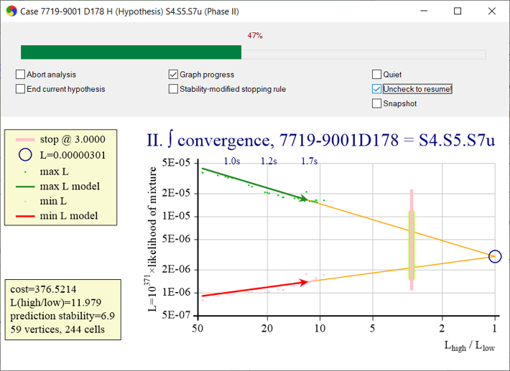
Calculation progress
Evaluating $H_{p}:mixture D_{178}= S_{4}+S_{5}+S_{6}+$ unknown.
Solves the problem of stopping calculation when a desired precision is reached.
(A classic impossible problem for MCMC.)
High-side so far
Predicted likelihood
Low-side so far
Stop!
Notes:
The X-axis is the precision, i.e. ratio of high-side to low-side estimates. Computation continues until the red and green arrows poke the target (“Stop!”) precision. Remarkably, extensions of the two arrow shafts -- least-squares fits to the low- and high-side calculations so far (dots) -- converge to the same “predicted likelihood” value at X=1.
In practice precision is considerably better than target precision.

Slide 7

Conclusions
Expert system
  Solves “number of contributors”
Math (not MCMC)
  Avoid black box
  More predictable, more malleable
    Handle locus-information linkage
    Predictable accuracy
  Really fast
    Two to 15 seconds for 2-3 person mixtures
    1 minute example 4-person mixture
      (and 4 more minutes to discount 5-person possibility)

Slide 8
Geschwindigkeit ist transformativ
10 minutes to compute:
  Think twice before doing
8 seconds:
  Test & experiment freely
  No need for human preliminary evaluation
  Do more tasks, e.g.:
    explore #’s of contributors
    test various possible contributors & combinations thereof

Slide 9
Design & implement by logic rather than mythology
Deconvolution as a step in calculation is a mistake - handcuffs & complicates

